Slide 1


IoT Based Office Monitoring and Control System
PREPARED BY :
SAYED MUHAMMAD ARIF FIKRI BIN SAYED ABDULLAH
SUPERVISOR :
DR. MOHD ADIB SARIJARI
Notes:
Why IoT technology
-as the technology can connected the smart devices.
My project title is…
A little explaination about iot(connect smart device bu using internet.

Slide 2
PRESENTATION OUTLINES
CONTENTS
INTRODUCTION
LITERATURE REVIEW
METHODOLOGY
WORK PLAN
RESULTS
CONCLUSION

Slide 3
INTRODUCTION

Slide 4
PROBLEM STATEMENT
Limited human ability to monitor and control office access and electrical devices 24 hours per day.
Prevent unauthorized access to the office.
The connection between the server and client either online or offline.
Notes:
1) Limited human ability to monitor and control the security system and electrical in office limited.
2) Prevent unauthorize access by suinf NFC technology.
3) The connection between server and client can disconnect wwtihin several time out. How does we find the method to minimize the error to detect either the client is online or offline.

Slide 5
OBJECTIVE
I
Develop IoT-based system to manage the access and monitor the authorize person enter and exit the building.
II
Develop IoT-Based system to monitor and control the electrical devices in the office.
III
Provide solution or method to detect either the client or server is connected/disconnected to the server.

Slide 6
SCOPE OF WORKS
The Things
Near field communication (NFC reader)
Lamp Control
The Cloud
Enterprise service (web-based software)
Network
Connectivity of things and network
Connectivity of web-based software and cloud
Magnetic lock
Gateway
Research
Provide a method to detect the connection within client and server.
Server
Notify the user when the connection lost between server and client.
Database
Gap Sensor
Light

Slide 7
LITERATURE REVIEW

Slide 8
RELATED WORK
TITLE AND AUTHOR | DESCRIPTION | COMMENT
AN ACCESS SYSTEM FOR BUILDINGS BASED ON SMARD CARDS[7] M.POPA,H.CIOCARLIE (2011) | The system using a smart card which is NFC or RFID to access point that connected to the server via the internet. | But, the system need some improvement in offline mode as the system collapse or stop when the connection to internet loss.
IOT-BASED SECURITY AND ACCESS SYSTEM FOR UTM RESIDENTIAL COLLEGE BUILDING [18] HERIANTO BIN UDIN (2018) | The project in the report is about implementing IOT based security access to building to prevent from not authorize person access to the building. The system include three main things only which are magnetic lock, NFC reader and raspberry pi. This system is suitable for implement in the office and building. | But the user do not know either the devices is always connected to the server or not as the system only monitor on the record person enter and out the buildings from the database.
Notes:
An Access System for Buildings based on smart cards
-using NFC to access the building.
-but the system will collapse when no internet connection

Slide 9
RELATED WORK
TITLE AND AUTHOR | DESCRIPTION | COMMENT
SMART DOOR SYSTEM FOR HOME SECURITY USING RASPBERRY PI 3[15] NASER ABBAS HUSSEIN (2017) | The proposed system provided the security system that suitable for home and office. The system include raspberry pi3, raspberry pi camera and keypad. The authorized person can enter the door by giving the correct password to the keypad and the door will open. The system has the ability to notify the user when the about the guest by taking the picture of the guest and sent it to the admin through the email. So the admin will decide to give the permission to enter or not. | The system only notify the user through the email. There is no specific web-based software used to make the system easier for the admin to handle it. Next, the system only notify the admin about the guest by taking that picture. The system not provide any solution on how to manage the connection between server and client. Then, the system do not provide any control system and only focuses on security system.
DESIGN AND EVALUATION OF WIRELESS HOME AUTOMATION SYSTEMS[16] MANIKANDAN J.(2016) | The project produce many design of home automation which are using different type of technology include Ethernet-based, IR-based, Bluetooth-based, RF-based, GSM-based and voice-based home-automation systems. All the system allow the user to control the electrical devices at home such as lamp and fan without need to switch off on the switch button. But, they can control them through the proposed design such as mobile phone apps using Bluetooth technology. | All the design produce the automation just only works inside the house only. Besides, the proposed system such as Bluetooth just work in short range. So the user need to be near to the controller to control the system using mobile software.
Notes:
Smart Door System for Home Security Using RPi3
-camera module and the keypad
-correct password can access
-notify the user identification by sending their image through the email.
-no specific user interface,the user need to alert the email.user interface may help to use the system easily.
-not notify the user when the error occur.
Design and evaluation of wireless home automation system
-used different technologies, Ethernet-based, IR based, Bluetooth-based
-enable to control the system such as lamp and fan remotely.
-improve by adding iot technology can enable long range control. Control via internet.
-not notify user when the error occur to the system. User need to check by themselves.

Slide 10
Fault Detection in Controller
Problem
Error can occur unexpectedly according to any condition such as lost power source or lost internet connection
Solution
Maintain the keep-alive condition between server and client to detect any connection lost which indicate the problem occur at the client site.
There connection between client and the server unknown either online or offline.
Notify the user via Telegram.
Notes:
Problem to tackle.
-Error can occur to electrical component
-any situation such as lost power source(blackout),error occur that can make the controller hang.
Solution
-the solution aready found in internet on how to nofify the by the internet.
-the Api can get free from telegram and can be used to send the user without any charge.
-Program controller to restart by itself
-reconnect to internet connection
-cloud notify the user and send the message through telegram.

Slide 11
PRODUCT COMPARISON
FEATURES | DOT COM | MAGNET | IOT-BASED SECURITY AND ACCESS SYSTEM (2017) | IOT PROPOSED PRODUCT
MULTI-TIER USER | ✗ | ✗ | ✓ | ✓
ACCESS CARD | RFID | RFID | NFC i.e identification card | NFC i.e identification card
CLOUD-BASED | ✓ | ✗ | ✓ | ✓
ERROR SOLUTION | ✗ | ✗ | ✗ | ✓
WEB-BASED SOFTWARE | ✓ | ✗ | ✓ | ✓
CUSTOMIZABLE AND UPGRADEABLE | ✗ | ✗ | ✓ | ✓
LIGHTING Control | ✗ | ✗ | ✗ | ✓
SUPPPORTED USER | LIMITED | LIMITED | unlimited | UNLIMITED
Notes:
Compared with other project.

Slide 12
METHODOLOGY
Notes:
PROJECT FLOW?

Slide 13
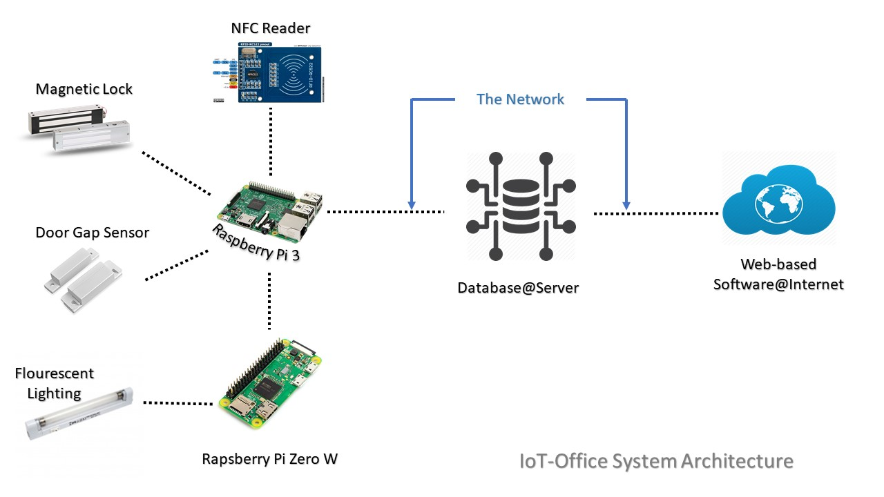
SYSTEM ARCHITECTURE
Notes:
System Architecture.
Consist of the things, cloud, and the network
At this part include the explanation on flow of the system

Slide 14

THE THINGS
RASPBERRY PI 3
Main controller to give instruction to the things connected to it.
As the Gateway of the IoT system
Spec:
  40-pin GPIO
  RAM 1GB
  Ethernet port
  Built in Bluetooth and WiFi
  Comm. Protocol – SPI, IC2
Notes:
Receive data from the cloud and receive the data from the server.
-MQTT broker to communicate with server and the things
What is MQTT?
Protocol.work as client or server to synchronize the data from the local network to the server

Slide 15




HEARTBEAT
Data Transfer
Via Telegram
The client
The User
The Server
Notes:
The connection between client and server. The client keep sending data periodically to the server in order to make sure that the connection between the server is alive. If the server did not receive any message from the user. The server will notify the user by sending a message via telegram.
Why telegram and not whatsapp?
Telegram provide freeAPI that provide for the developer to make a program using API. Open source.

Slide 16
WORK PLAN

Slide 17
Gantt Chart FYP1
No | Task Activity | Year 2017/2018
 |  | W1 | W2 | W3 | W4 | W5 | W6 | W7 | W8 | W9 | W10 | W11 | W12 | W13 | W14 | W15
1 | Discuss title of project with supervisor
2 | Literature review
3 | Identify the objective and scope of the project
4 | Study the proposed project
5 | Learn and explore the Raspberry pi platform
6 | Identify and explore, other hardware and software involved
7 | FYP1 presentation
9 | Documentation
10 | Report Submission

Slide 18
Gantt Chart FYP2
No | Task Activity | Year 2017/2018
 |  | W1 | W2 | W3 | W4 | W5 | W6 | W7 | W8 | W9 | W10 | W11 | W12 | W13 | W14 | W15
1 | Design the prototype using Solidwork software
2 | Build the prototype model with all the hardware need
3 | Develop the user interface
4 | Develop the lamp control system
5 | UI development for the system
6 | Analysis of error occur in connection
7 | Integrated and testing the system
8 | Performance evaluation and analysis
9 | Journal Paper submission
10 | EES 2018
9 | Documentation
10 | Report Submission

Slide 19
PROJECT COST
No. | Description | Price
1. | Raspberry Pi 3 | RM 295.00
2. | Raspberry Pi Zero W (2 set) | RM 100.00
3. | Magnetic Lock | RM 120.00
4. | NFC Reader (2 set) | RM 30.00
5. | Door Gap Sensor | RM 15.00
6. | Fluorescent Lighting (2 set) | RM 24.00
7. | D-link DWA-123 Wireless Adapter | RM 23.00
8. | Others | RM 30.00
 | Total | RM 637.00
Notes:
Add
-web based software login page
-focus several coding
-door lock with magnetic lock
-show specific coding

Slide 20
RESULTS
Notes:
Add
-web based software login page
-focus several coding
-door lock with magnetic lock
-show specific coding

Slide 21
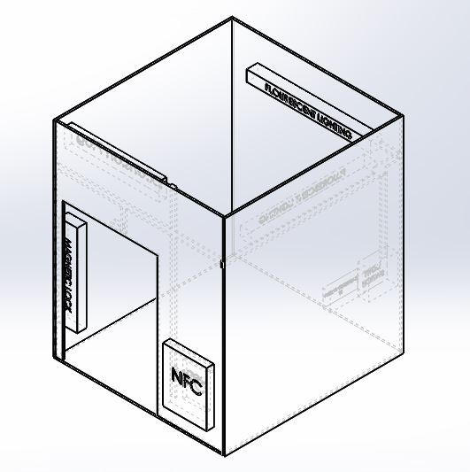
Prototype Model Design
Design prototype by using Solidworks software before build the real one.
The prototype consist all the hardware of the system.
Notes:
As in the Gantt chart include the learning process and explore process
-attend the IoT workshop, this is the module training for Raspberry pi

Slide 22
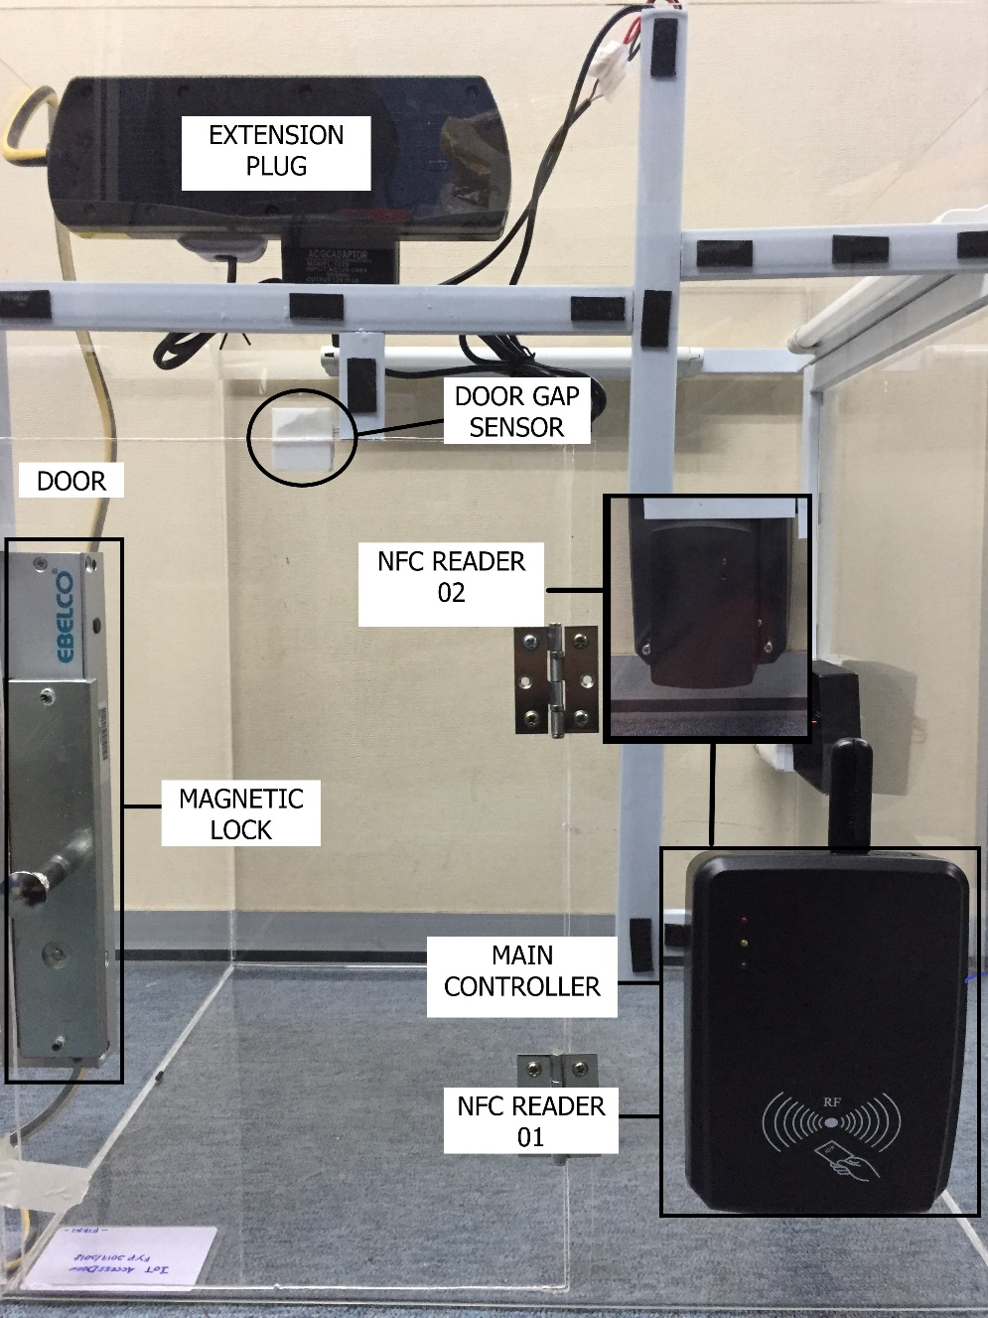
The Hardware implementation
The view of the main controller of the system.
The hardware:
  Magnetic Lock
  NFC Reader
  Gap Sensor
  Raspberry Pi 3

Slide 23
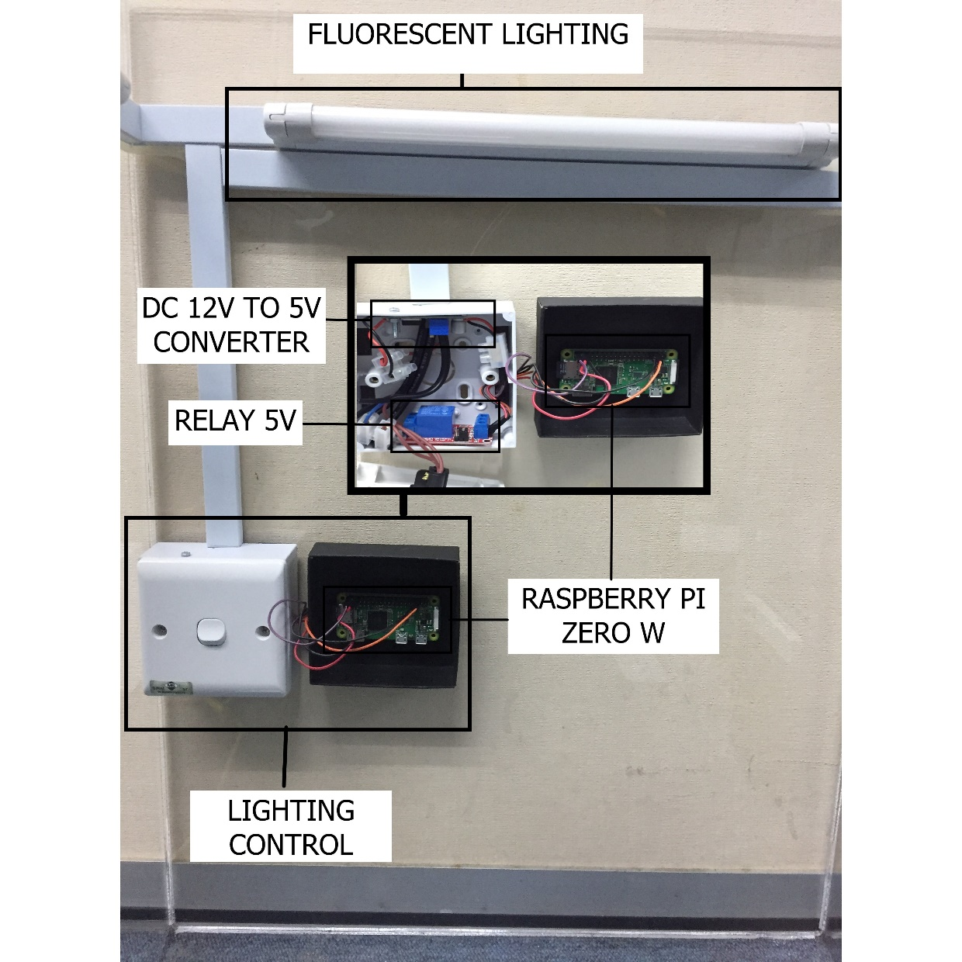
The hardware implementation
The view of the light controller of the system.
The hardware:
  Raspberry Pi Zero w
  DC 12V to 5V converter
  5V Relay
  Fluorescent Lighting

Slide 24
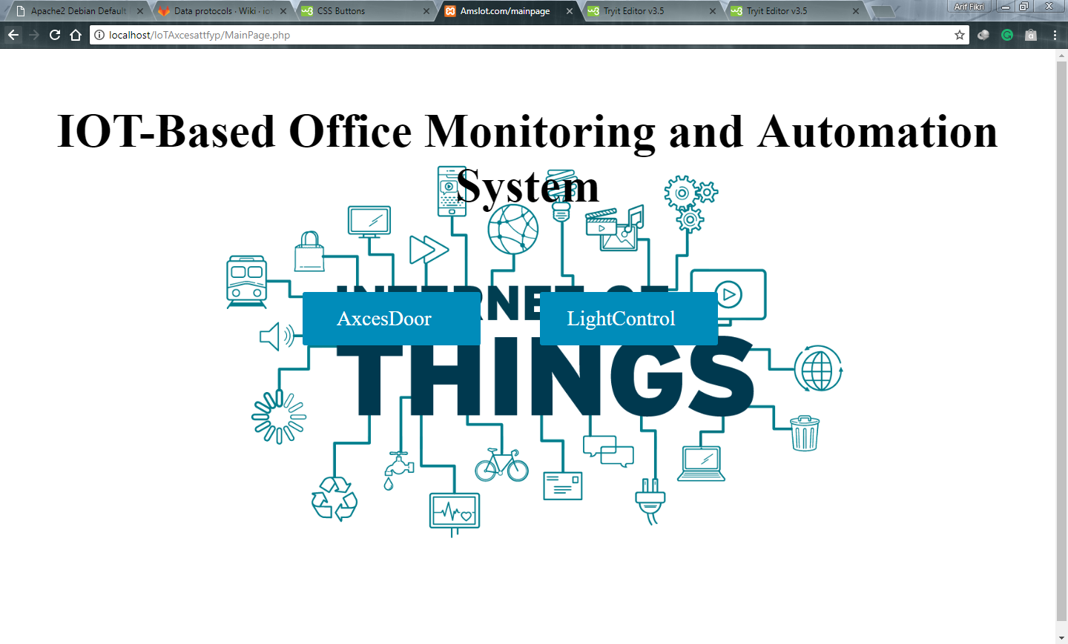
Graphical User Interface
Main Page
Notes:
Ths the ui login page development phase one,

Slide 25
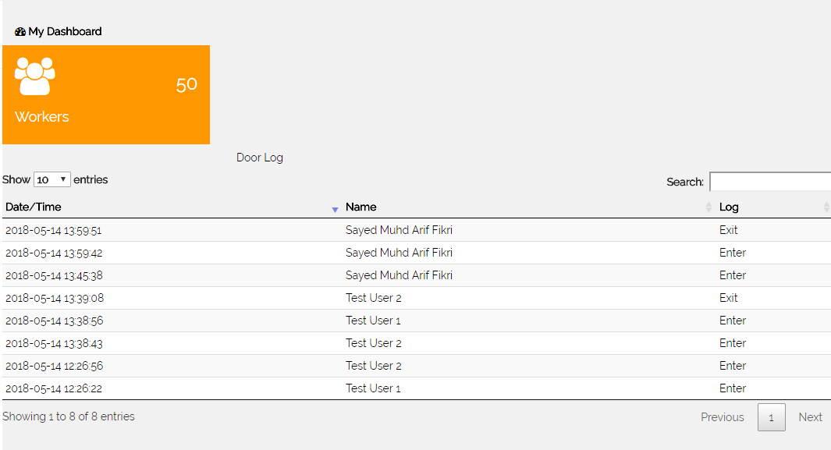
Graphical User Interface
Door Log Page
Notes:
Ths the ui login page development phase one,

Slide 26
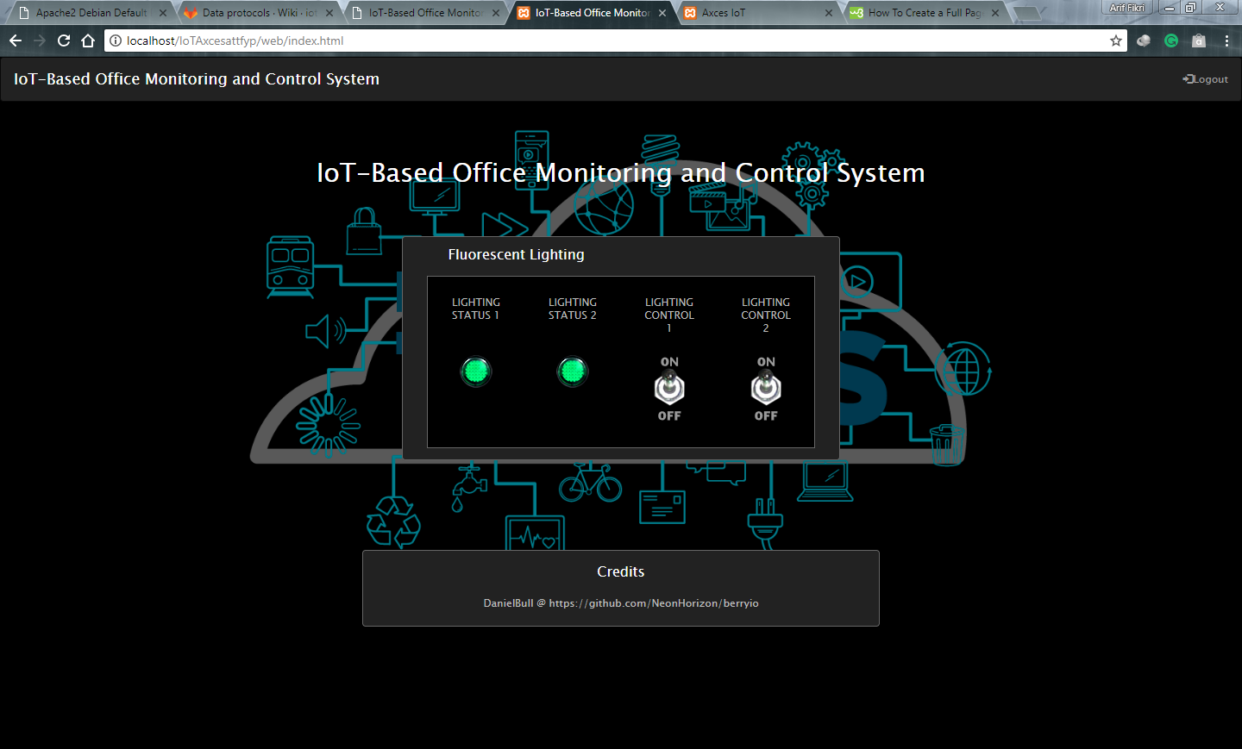
Graphical User Interface
Lighting Control Page
Notes:
Ths the ui login page development phase one,

Slide 27
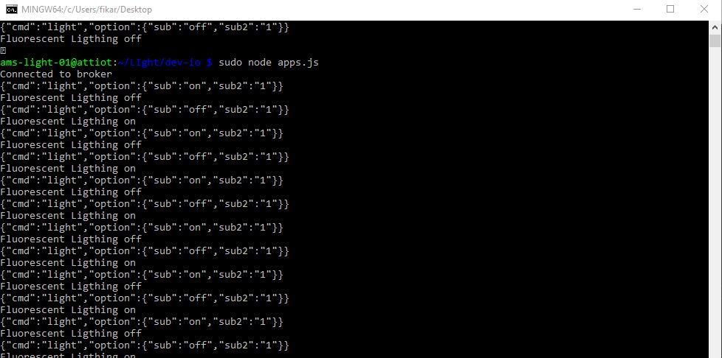
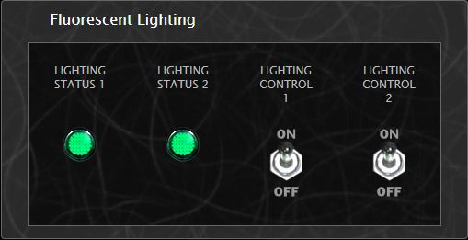
MQTT application for lighting control
Fluorescent Lighting Control Panel
MQTT-client Log

Slide 28
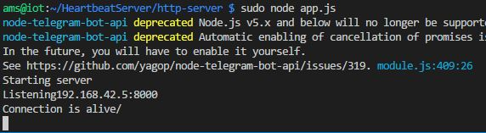
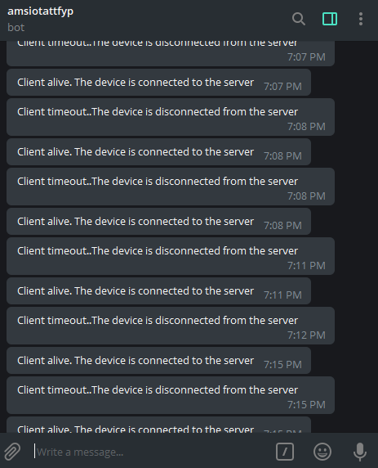
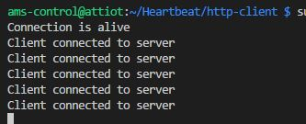
Heartbeat
The Server
The Client
Notify User via Telegram
Heartbeat Process

Slide 29
CONCLUSION
All tasks in FYP2 schedule were successfully executed and completed, accordingly.
Prototype has been developed including office with door installed with magnetic lock, Raspberry Pi programmed to read NFC-based card and open the door if authenticated.
Next, in the future, the developed prototype will be further completed including with adding more features such as adding more remotely control device such as fan.

Slide 30
REFERENCES
M. Fell, “ Roadmap for The Emerging Internet of Things”, Carre & Strauss,2014.
J. Gubbi, R. Buyya, S. Marusic, and M. Palaniswami, “Internet of Things (IoT): A vision, architectural elements, and future directions,” Future Generation Computer Systems, vol. 29, no. 7, pp. 1645–1660, 2013.
L. Atzori, A. Iera, and G. Morabito, “The Internet of Things: A survey,” Computer Networks, vol. 54, no. 15, pp. 2787–2805, 2010.
A. V. Jerald, S. A. Rabara, and D. P. Bai, “Algorithmic Approach to Security Architecture for Integrated IoT Smart Services Environment,” 2017 World Congress on Computing and Communication Technologies (WCCCT), 2017.
R. Minerva, A. Biru, and D. Rotondi,”Towards a definition of the Internet of Things(IoT),”IEEE Internet Things, no. 1,p. 86, 2015.
Y.-W.Bai and S.-C.Chen,’Design and Implementation of Home Intercom and Security Control Systems for Buildings,’ in 2007 IEEE International Symposium on Consumer Electronics, 2007,pp. 1-6.
M. Popa and H. Ciocarlie, “An access system for buildings based on smart cards,” 2011 IEEE 9th International Symposium on Applied Machine Intelligence and Informatics (SAMI), 2011.
dzone.com. (2017). SQL vs. NoSQL - DZone Database. [online] Available at: http://dzone.com/articles/sql-vs-nosql [Accessed 13 Dec. 2017].
A. D. Deshmukh and U. B. Shinde, “A low cost environment monitoring system using raspberry Pi and arduino with Zigbee,” 2016 International Conference on Inventive Computation Technologies (ICICT), 2016.
P. Ray, “A Survey on Internet of Things Architectures,” EAI Endorsed Transactions on Internet of Things, vol. 2, no. 5, p. 151714, Jan. 2016.

Slide 31
REFERENCES
“Raspberry Pi 3 Model B,” Raspberry Pi. [Online]. Available: https://www.raspberrypi.org/products/raspberry-pi-3-model-b/. nosql [Accessed 13 Dec. 2017].
“MQTT,” MQTT RSS. [Online]. Available: http://mqtt.org/. nosql [Accessed 13 Dec. 2017].
“ESPresso Lite V2.0 Arduino ESP8266 WiFi Module,” RobotShop. [Online]. Available: https://www.robotshop.com/en/espresso-lite-v20-arduino-esp8266-wifi-module.html. nosql [Accessed 13 Dec. 2017].
P. Jayaram, “SQL vs. NoSQL - DZone Database,” dzone.com, 24-Mar-2017. [Online]. Available: https://dzone.com/articles/sql-vs-nosql.
N. A. Hussein and I. A. Mansoori, “Smart Door System for Home Security Using Raspberry pi3,” 2017 International Conference on Computer and Applications (ICCA), 2017.
M. J., “Design and evaluation of wireless home automation systems,” 2016 IEEE 1st International Conference on Power Electronics, Intelligent Control and Energy Systems (ICPEICES), 2016.
N.Z Azman, “IoT-Based Home Intercom System”,FYP Thesis, Universiti Teknologi Malaysia, Johor Bahru, Malaysia, 2016.
H. Udin, “IoT-Based Security and Access System for UTM Residential College Building”, FYP Thesis, Universiti Teknologi Malaysia, Johor Bahru, Malaysia, 2017

Slide 32
THANK YOU
Notes:
Why telegram?
-provide APIs free of charge
-telegram provide for developer.
MQTT broker?
-connect the data between thing and server. synchronize the data.
SPI&I2C(serial peripheral interface&inter-intergrated-circuit bus
-useful bus that allows data exchange between microcontroller and peripherals with minimum of wiring
ESPb266 ESPresso
-high performace
-intergrated wireless soc

